Slide 1

Using Data science for relocation

Slide 2
Purpose
The pupose of this project was to identify areas in another city that are similar to my current living are using data from the foursquare data base

Slide 3
Data collection and processing
Data was collected by scraping two webpages:
  Worldpostalcodes.org
  Postnummerservice.se
Two data bases were also used
  PAP/Lite database
  Foursquare
The postal codes and coordinates from worldpostalcodes.org were used but with the city names from the PAP/Lite data base.
The 20 closest venues from foresquare were collected for each postal code. In total, 786 postal codes were included in the data set.

Slide 4
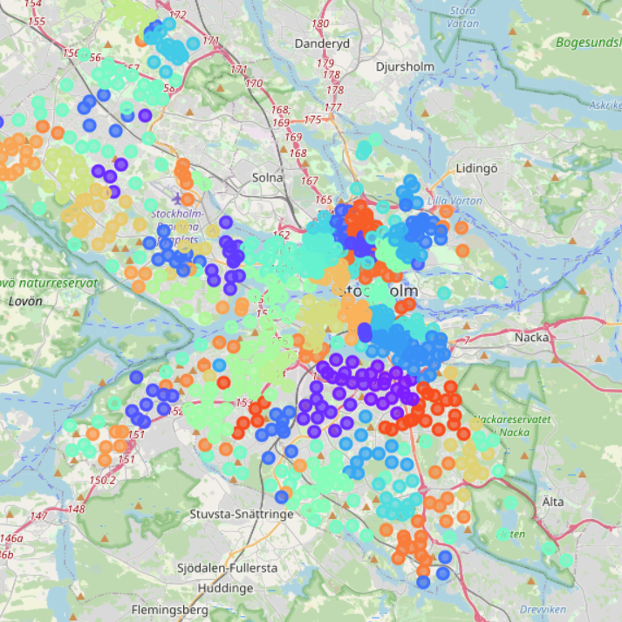
Results
The postal codes in Stockholm were clustered
The Kmeans algorithm had its best performance when initiating 44 clusters
The current postal code was in cluster 1 along with 12 other postal codes

Slide 5
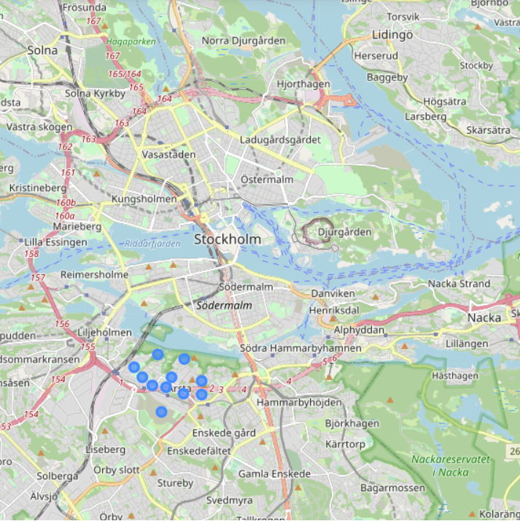
Recommendation
12 postal codes in Årsta, Stockholm were identified as being similar to my current postal code

Slide 6
Conclusion
12 potential new postal codes were identified which can help inform relocation decision
The cluster was not extremely similar to my current postal code – other data points may be better suited, or other methods such as weighing the attributes somehow.

